Slide 1
Assignment 2: Pacemaker
Group 26: Sherjeel shehzad and kevin tang

Slide 2
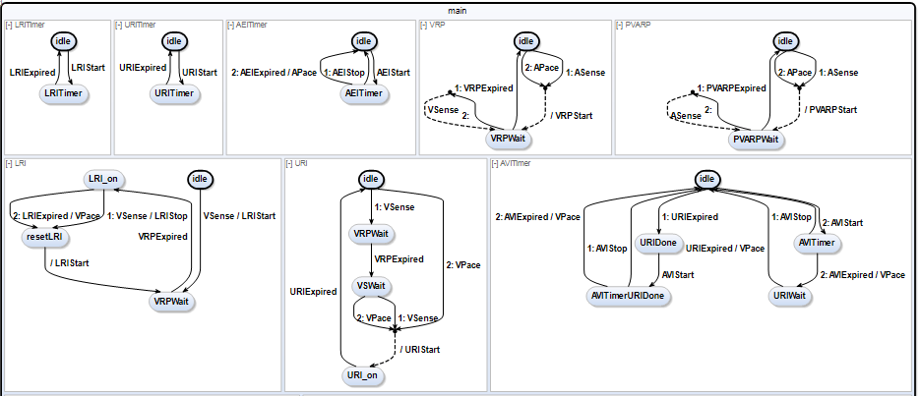
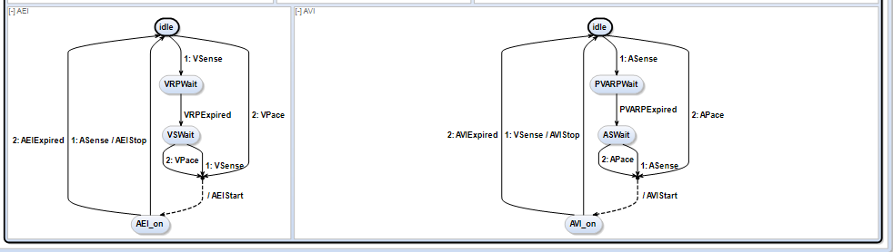
SCCharts Overview

Slide 3
Disease Prevention

Slide 4
Two Content Layout with Table
First bullet point here
Second bullet point here
Third bullet point here
Class | Group A | Group B
Class 1 | 82 | 95
Class 2 | 76 | 88
Class 3 | 84 | 90

Slide 5
Two Content Layout with SmartArt
First bullet point here
Second bullet point here
Third bullet point here
Step 1
Task Description
Task Description
Step 2
Task Description
Task Description
Step 3
Task Description
Task Description

Slide 6
Add a Slide Title - 1

Slide 7
Add a Slide Title - 2

Slide 8
Add a Slide Title - 3

Slide 10
Add a Slide Title - 4

Slide 11
Add a Slide Title - 5

